Slide 1
Mini Project Price Comparison through Web Scrapping
Mr. Yashraj Vibhute B-65
Mr. Kedar Swami B-58
Mr. Ishwar Dama B-74
Project Guided by- Prof. M. Rangdal Sir

Slide 2
Problem Statement:-
To develop an efficient interface for the investors to monitor the price of different crypto currencies from different websites at same time.

Slide 3
Web Scraping
Web scraping is an automatic method to obtain large amounts of data from websites. Most of this data is unstructured data in an HTML format which is then converted into structured data in a spreadsheet or a database so that it can be used in various applications.
Web Scrapers can extract all the data on particular sites or the specific data that a user wants. Ideally, it’s best if you specify the data you want so that the web scraper only extracts that data quickly.
Python seems to be in fashion these days! It is the most popular language for web scraping as it can handle most of the processes easily. It also has a variety of libraries that were created specifically for Web Scraping.

Slide 4
Literature Survey
Ram Sharan Chaulagain, Santosh Pandey, Sadhu Ram Basnet Cloud Based Web Scraping for Big Data Applications, Smart Cloud (SmartCloud) IEEE conference, 2017
Hirschey, J. K. (2014). Symbiotic relationships: Pragmatic acceptance of data scraping. Berkeley Technology Law Journal, 29, 897.
O’Reilly, S. (2006). Nominative fair use and Internet aggregators: Copyright and trademark challenges posed by bots, web crawlers and screen-scraping technologies. Loyola Consumer Law Review, 19, 273.

Slide 5
Ways to Scrape Web:
Web Scraping can be done efficiently through majorly three ways:
1) Selenium is an open source umbrella project for a range of tools and libraries aimed at supporting browser automation. It provides a playback tool for authoring functional tests across most modern web browsers, without the need to learn a test scripting language.
2) Scrapy is a very popular open-source web crawling framework that is written in Python. It is ideal for web scraping as well as extracting data using APIs.
3) Beautiful soup is another Python library that is highly suitable for Web Scraping. It creates a parse tree that can be used to extract data from HTML on a website. Beautiful soup also has multiple features for navigation, searching, and modifying these parse trees.

Slide 6
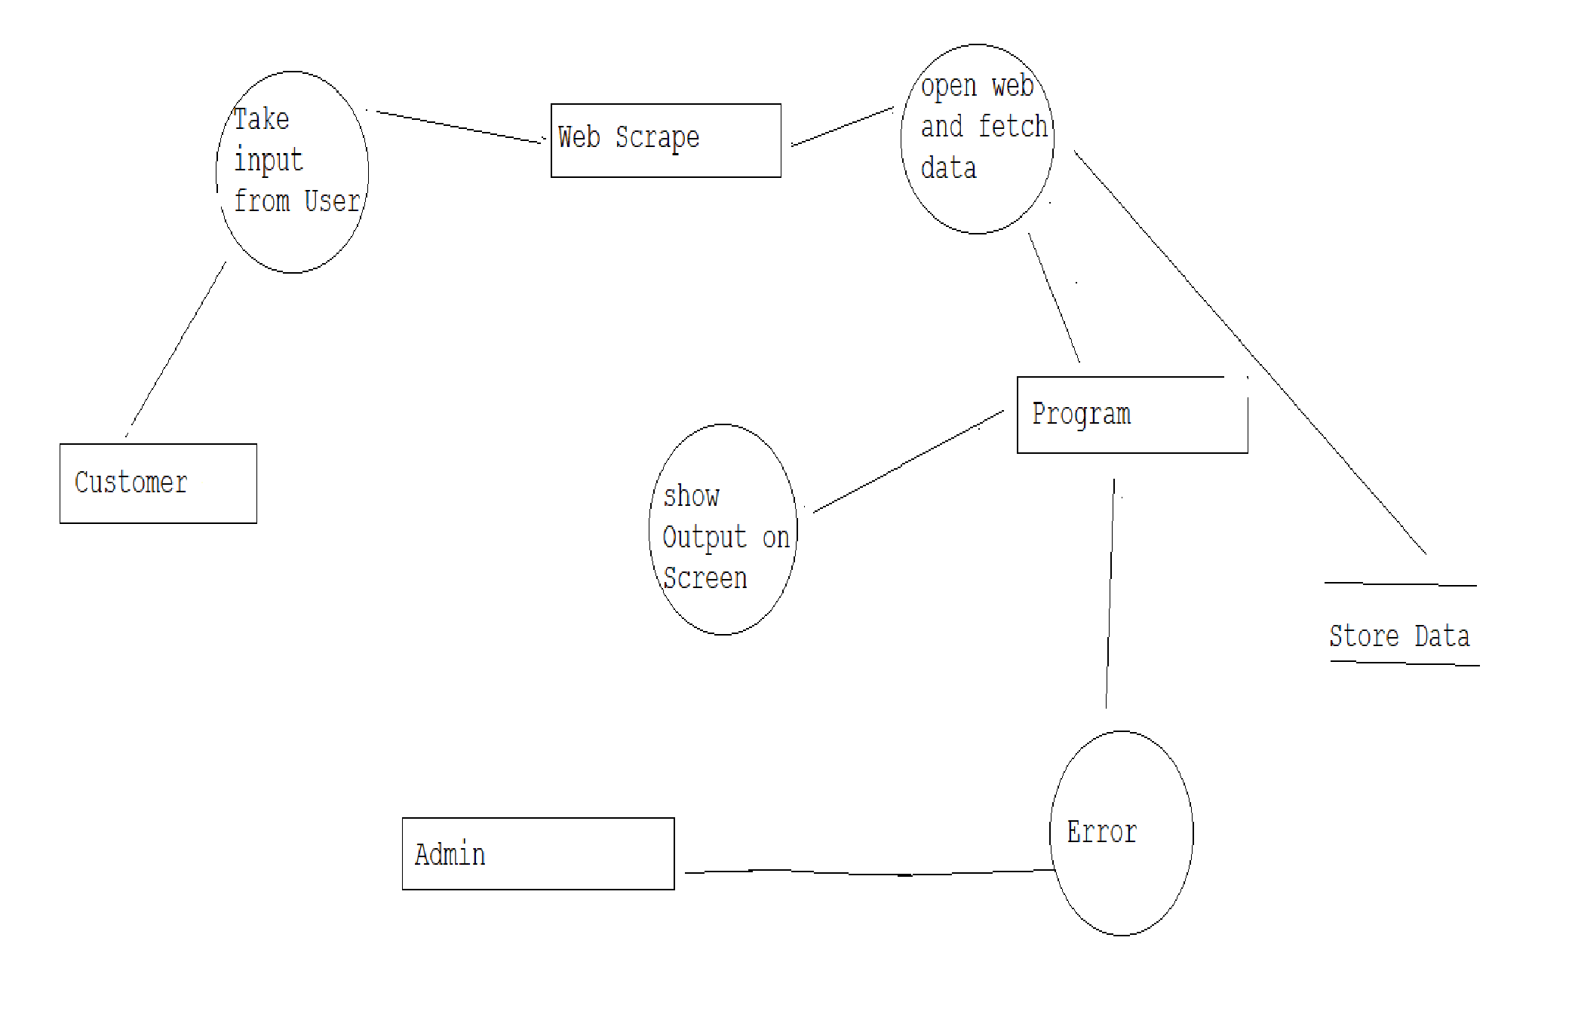
Data Flow Diagram(DFD)

Slide 7
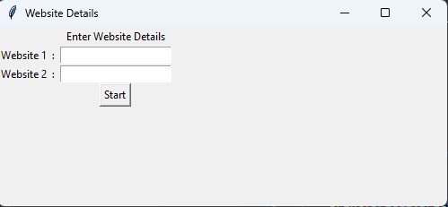
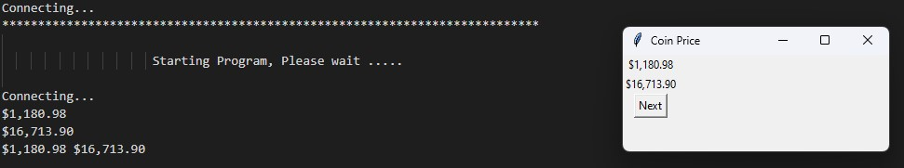
Glimpse of Project
3.2
Interface Design
1

Slide 8
Advantages
Web Scraping has multiple applications across various industries. Let’s check out some of these now!
1. Price Monitoring
Web Scraping can be used by companies to scrap the product data for their products and competing products as well to see how it impacts their pricing strategies. Companies can use this data to fix the optimal pricing for their products so that they can obtain maximum revenue.
2. Market Research
Web scraping can be used for market research by companies. High-quality web scraped data obtained in large volumes can be very helpful for companies in analysing consumer trends and understanding which direction the company should move in the future.

Slide 9
3. News Monitoring
Web scraping news sites can provide detailed reports on the current news to a
company. This is even more essential for companies that are frequently in the news or
that depend on daily news for their day-to-day functioning. After all, news reports can
make or break a company in a single day!
4. Sentiment Analysis
If companies want to understand the general sentiment for their products among
their consumers, then Sentiment Analysis is a must. Companies can use web scraping to
collect data from social media websites such as Facebook and Twitter as to what the
general sentiment about their products is. This will help them in creating products that
people desire and moving ahead of their competition.

Slide 10
5. Email Marketing
Companies can also use Web scraping for email marketing. They can collect
Email IDs from various sites using web scraping and then send bulk promotional and
marketing Emails to all the people owning these Email IDs.

Slide 11
Conclusion
Large Market
Traffic and Server Load
Need of innovations

Slide 12
References
https://www.crummy.com/software/BeautifulSoup/bs4/doc/
Web Scraping with Selenium. This is the third part of a 4 part… | by Karthikeyan P | Towards Data Science

Slide 13
Thank You!

